Slide 1
Currency Converter
by
Sayed Mahmud
ID-193313006
Batch -6th

Slide 2
Abstract
In finance, an exchange rate between two currencies is the rate at which one currency will be exchange for another.
It is useful tool which gives us the value of certain amount of one currency to different currency
In this project we are going to display a tools window in which currency options are given and the conversion value is displayed in the result window

Slide 3
Table of contents
Introduction
Algorithm
Flowchart
Coding
Conclusion

Slide 4
Introduction
Currency converter is a tool used to convert one country’s currency to another.
In this project by the knowledge of usage of currency converter a program is designed in java language.
In this currency converter application, it is going to display a window where u can input the currency for the exchange rate of another currencies in the form of table.

Slide 5
Algorithm
Step-1 : Start
Step-2 : Enter the amount value.
Step-3 : Click on the convert Button.
Step-4 : The Value will be displayed.
Step-5 : Exit.

Slide 6
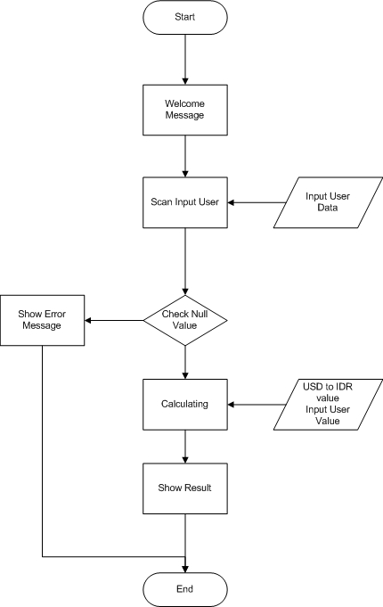
Flow Chart

Slide 7
Design
We are using java swift for the GUI interface,
Table for currency Name and Result,
Text button for convert action,
Text level for pointing which currency located where.
Text box for output of currency convert
This code is implemented by using geany (ide)

Slide 8
Introduction of Program (Header file)
package currencyconverter;
import javax.swing.*;
import java.awt.*;
import java.awt.event.*;
public class CurrencyConverter

Slide 9
For displaying of table
public static void converter()
{ JFrame f = new JFrame("CONVERTER");
JLabel l1, l2; JTextField t1, t2; JButton b1, b2, b3;
l1 = new JLabel("Rupees:"); l1.setBounds(20, 40, 60, 30);
l2 = new JLabel("Dollars:"); l2.setBounds(170, 40, 60, 30);
t1 = new JTextField("0"); t1.setBounds(80, 40, 50, 30);
t2 = new JTextField("0"); t2.setBounds(240, 40, 50, 30);
b1 = new JButton("INR"); b1.setBounds(50, 80, 60, 15);
b2 = new JButton("Dollar"); b2.setBounds(190, 80, 60, 15);
b3 = new JButton("close"); b3.setBounds(150, 150, 60, 30);

Slide 10
Converting the currency
b1.addActionListener(new ActionListener() {
public void actionPerformed(ActionEvent e)
{
double d = Double.parseDouble(t1.getText());
double d1 = (d / 65); String str1 = String.valueOf(d1); t2.setText(str1);
}});
b2.addActionListener(new ActionListener() {
public void actionPerformed(ActionEvent e)
{ double d2 = Double.parseDouble(t2.getText());
float d3 = (float) (d2 * 65); String str2 = String.valueOf(d3); t1.setText(str2);
}});

Slide 11
Show the result & close the form
b3.addActionListener(new ActionListener() {public void actionPerformed(ActionEvent e)
{ f.dispose();
}});
f.addWindowListener(new WindowAdapter() {public void windowClosing(WindowEvent e)
{ System.exit(0);}
});
f.add(l1); f.add(t1); f.add(l2); f.add(t2);
f.add(b1); f.add(b2); f.add(b3);
f.setLayout(null); f.setSize(400, 300); f.setVisible(true);}
public static void main(String args[])
{converter();}
}

Slide 12
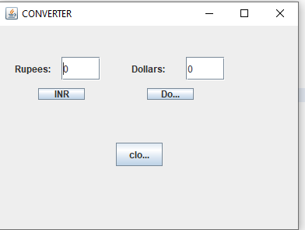
Result

Slide 13
Conclusion
Therefore, currency converter is developed and is used for knowing the currency’s value.
It can be further developed by including more currency options and by shown currency value tables for the user

